Slide 1
Dropbox
Dublin Ireland

Slide 2

Founded in 2013
Headquarters
San Francisco, California, United States
No. Of Employees : 220 , over 20 nationalities
Business Type : a file sharing and cloud storage solution that employees love and IT admins trust.

Slide 3
About
Dropbox is a file hosting service operated by the American company Dropbox, Inc., headquartered in San Francisco, California, that offers cloud storage, file synchronization, personal cloud, and client software. Dropbox was founded in 2007 by MIT students Drew Houston and Arash Ferdowsi as a startup company, with initial funding from seed accelerator Y Combinator.
Dropbox brings files together in one central place by creating a special folder on the user's computer. The contents of these folders are synchronized to Dropbox's servers and to other computers and devices where the user has installed Dropbox, keeping the same files up-to-date on all devices.

Slide 4
“Our mission is to unleash the world's creative energy by designing a more enlightened way of working.”
–Mission Statement

Slide 5
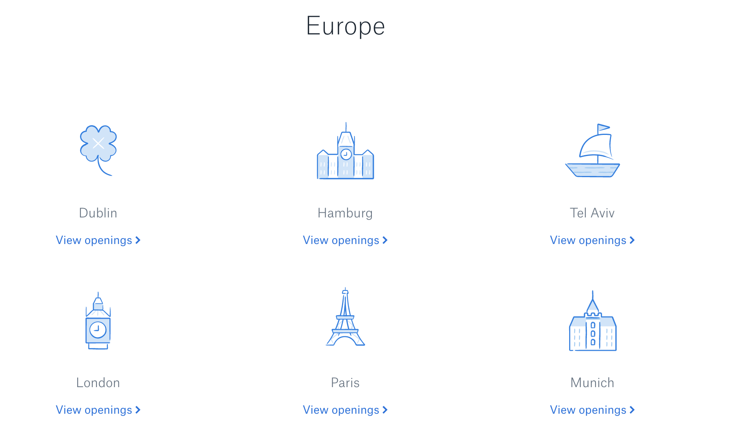




Main Locations

Slide 6
Acquisitions
2009 : Steve Jobs approaches Drew Houston and suggests that Drew Houston sell Dropbox. Drew Houston cuts the pitch short and says that Dropbox is determined to stay independent.
2012:Dropbox acquires stealth startup Cove .
2014 :Dropbox acquires Hackpad, a real-time collaborative text editor.
Dropbox acquires Mailbox, a sleek email platform specifically for mobile users.

Slide 7
Partnerships
Dropbox uses a freemium business model, where users are offered a free account with a set storage size, with paid subscriptions available that offer more capacity and additional features.
2012, Facebook and Dropbox integrated
In 2013, Samsung pre-loaded the Dropbox mobile application on its Android devices
2018 : Dropbox announced its partnership with Salesforce aiming to improve brand engagement and team productivity
2014, Dropbox announced a partnership with Microsoft to integrate Dropbox and Microsoft Office

Slide 8

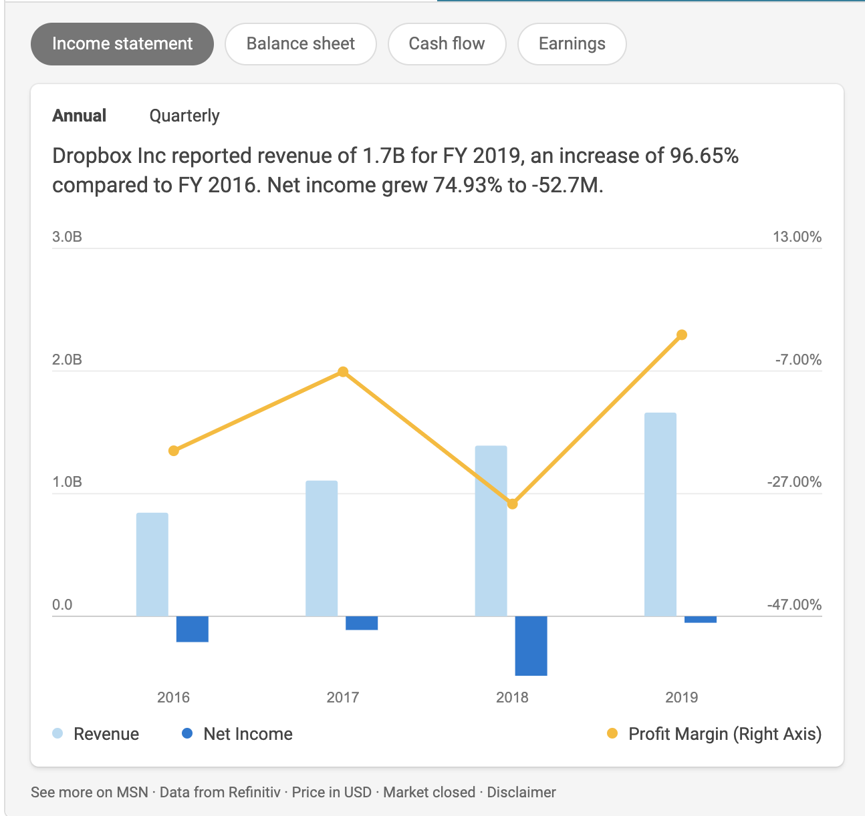
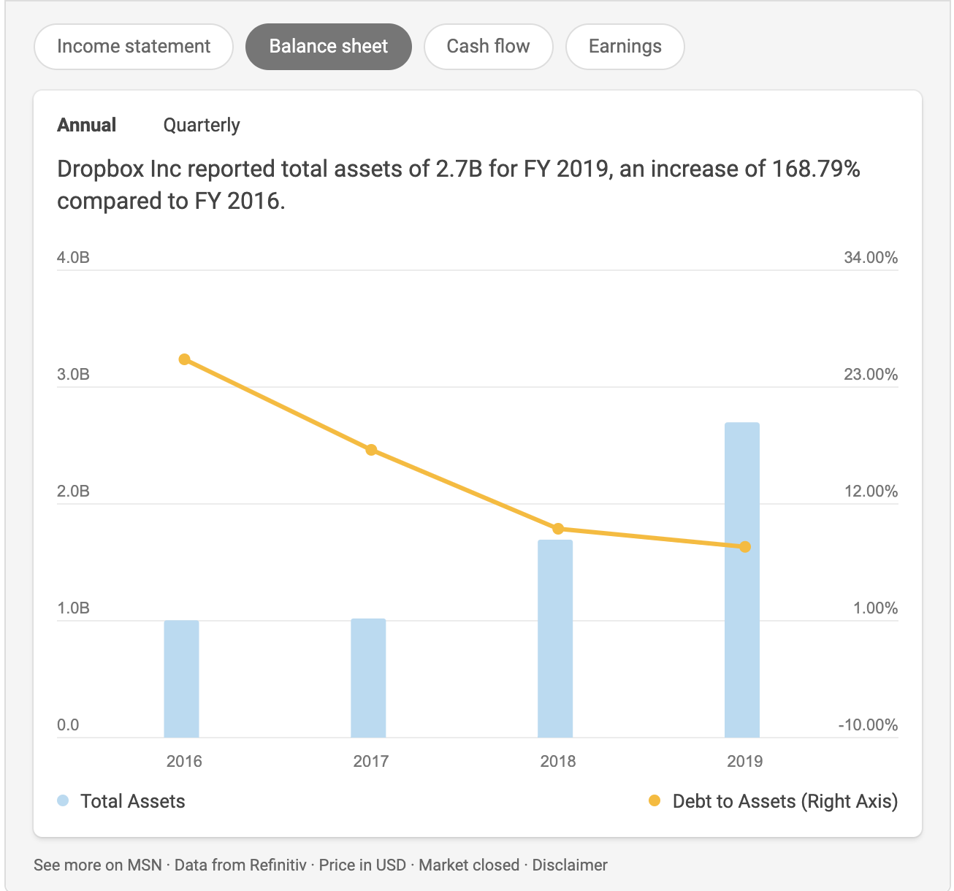
Financials

Slide 9
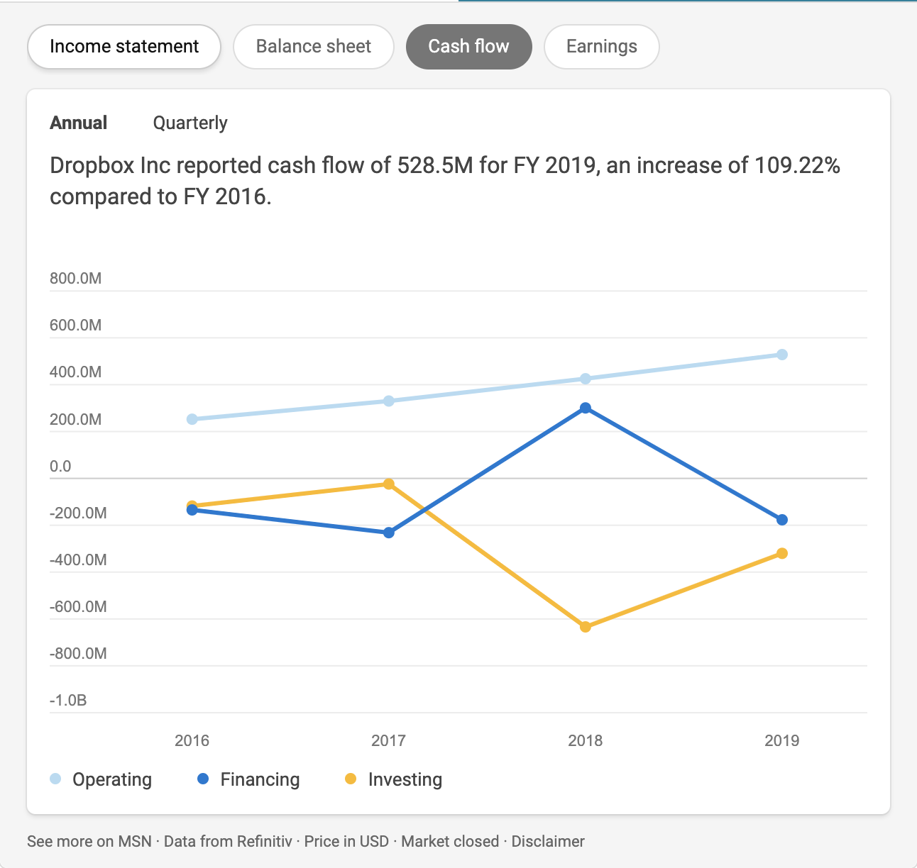
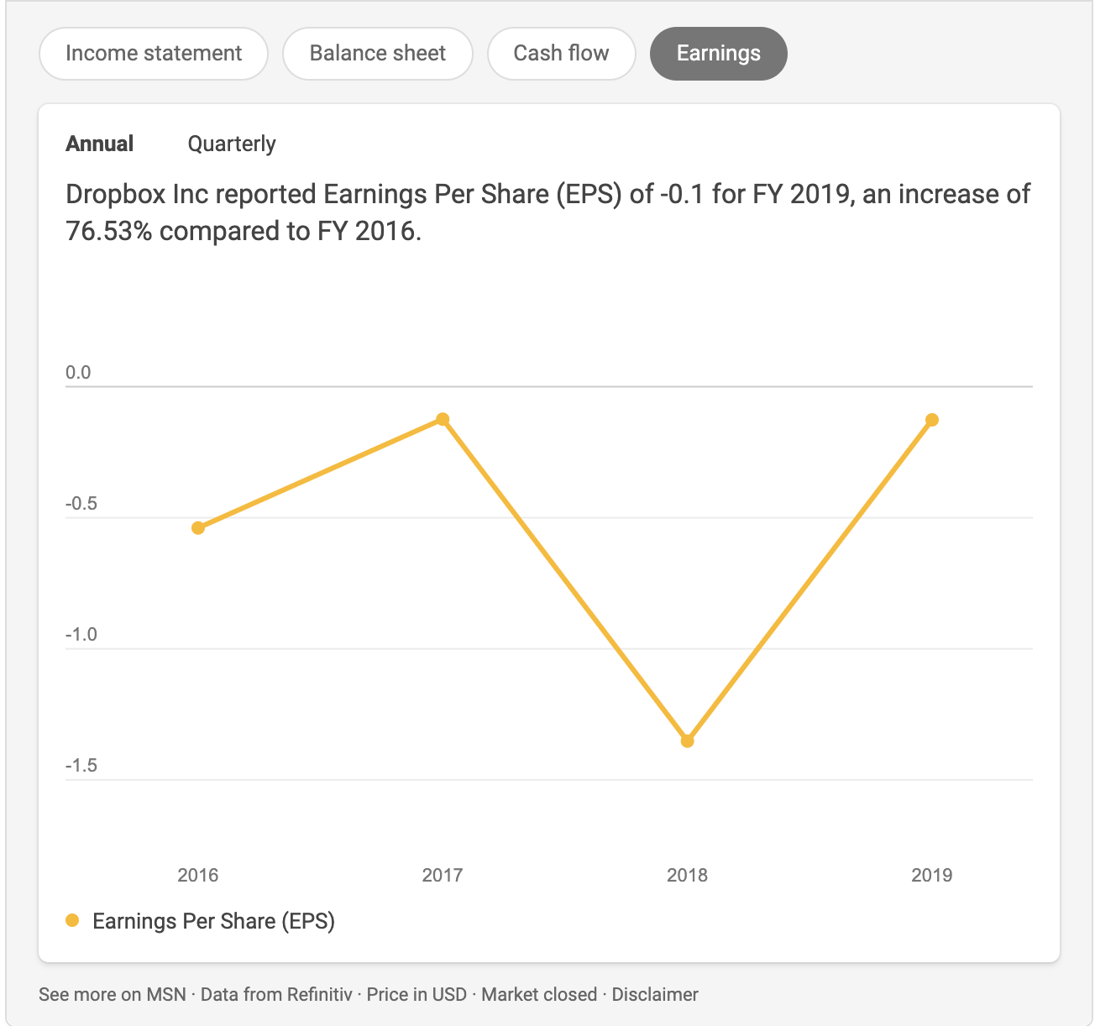
Financials

Slide 10
Community Service
CASA
CASA works with and supports people with all disabilities – physical, sensory and intellectual – of all ages and from all backgrounds.
Solas Project
Solas Project is a Dublin-based community development charity that works to address the imbalances that contribute to children growing up at a socio-economic or educational disadvantage.

Slide 11
Other information
Dropbox has been ranked as one of the most valuable startups in the US and the world, with a valuation of over US$10 billion
Great place to work
Has gym
Cafeteria
Bringing people together
Work life balance

